Slide 1
Why model?
Nim Arinaminpathy
MRC Centre for Outbreak Analysis and Modelling Faculty of Medicine Imperial College London

Slide 2
Introduction to the course
Aim: Biology → Model → Solutions
Also critical assessment of a model
Mix of lectures and practicals
Covering a range of important infectious diseases in humans
In this lecture we will touch on some basic concepts

Slide 3
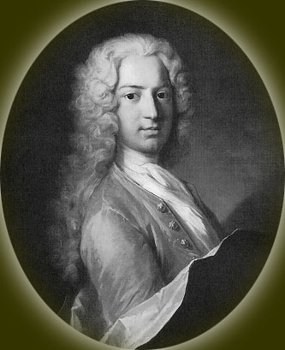
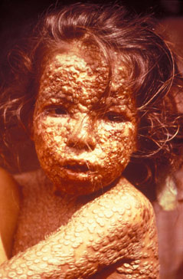
Motivation
Daniel Bernoulli
(1700-1782)
On smallpox inoculation: “I simply wish that, in a matter which so closely concerns the well-being of mankind, no decision shall be made without all the knowledge which a little analysis and calculation can provide.”

Slide 4

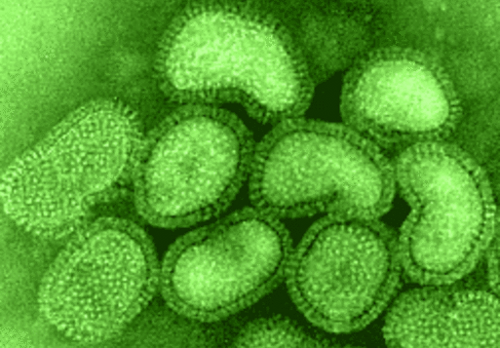
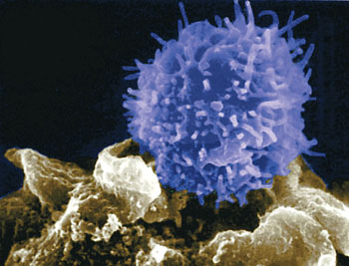



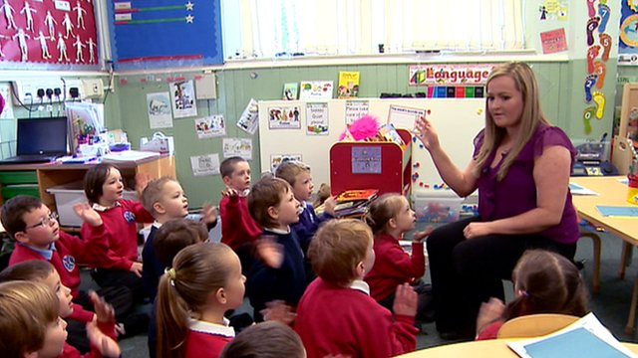
How can modelling possibly work?

Slide 5
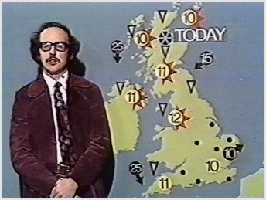





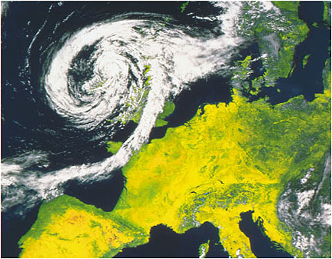
Weather forecasting

Slide 6


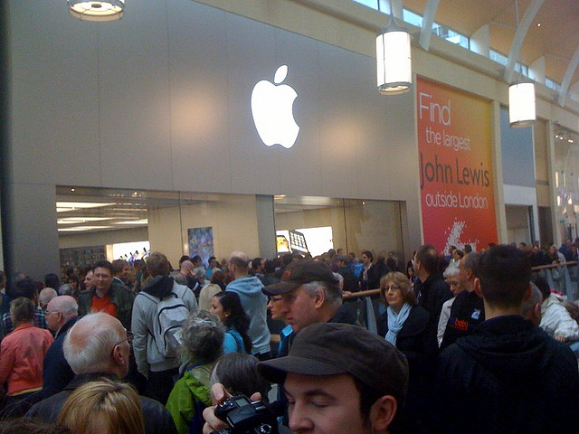
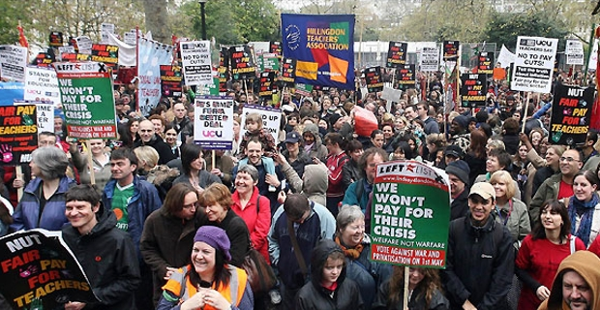

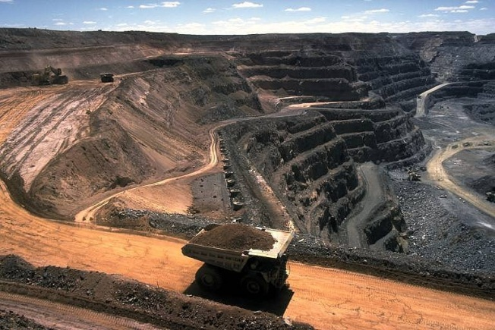
Economic modelling

Slide 7

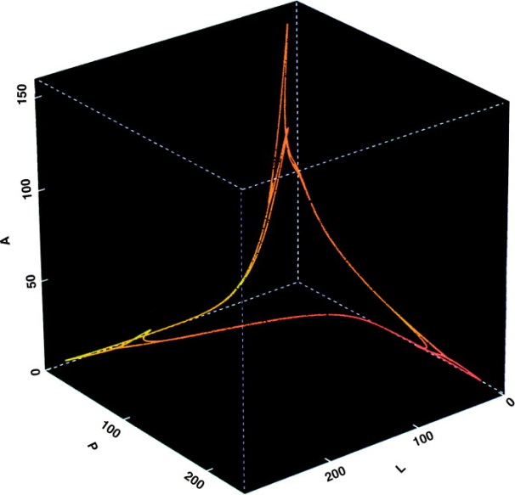

Complex systems &
non-linear dynamics
Complex systems show emergent collective dynamics.
Non-linear – feedback important.
Low-dimensional – characterised by a few order parameters.
May not be predictable (chaos, stochasticity).

Slide 8
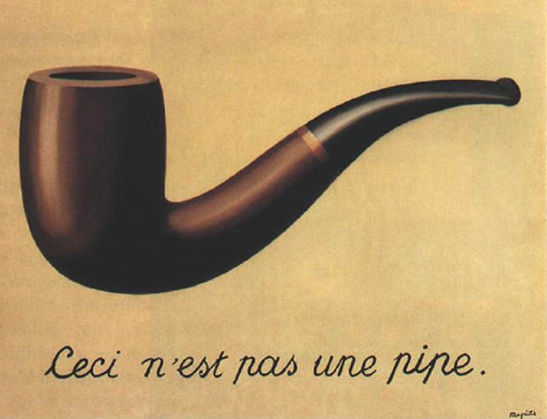
Simplification essential
“All models are wrong, but some are useful.”
George E.P. Box
René Magritte
The art of modelling is knowing what to leave out

Slide 9
Key uses of models
?
Analysing data, interpreting pattern.
Informing control policy design.
(Prediction).

Slide 10
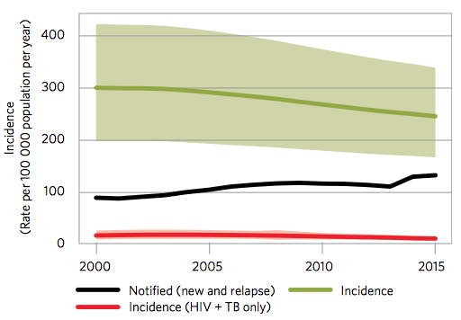
Endemic vs Epidemic diseases
Endemic: those that are established in the population and display ‘slowly varying’
dynamics, e.g. HIV, Tuberculosis in high-burden settings
HIV time series
TB in the South-East
Asian Region
Annual Cases
3000
2500
2000
1500
1992
1994
1996
1998
Year
Epidemic: those that cause outbreaks, whether sporadic or regular, e.g. measles,
pandemic influenza
Measles time series
2009 Pandemic influenza in the USA (US CDC)
Weekly Cases
1000
800
600
400
200
1948
1950
1952
1954
1956
1958
1960
Year

Slide 11
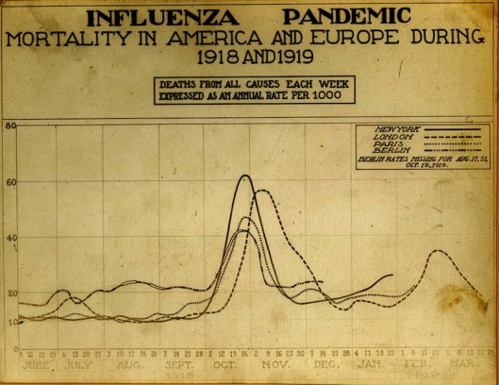
Outbreaks
Particular challenging context
Two aspects:
Modelling for preparedness
Real-time analysis
Not fundamentally different from endemic disease modelling
And many parallels with elimination programmes (e.g. polio)
Cost-benefit – critical aspect, not discussed here

Slide 12



Expert input to decision-making
Rarely asked: ‘tell us what to do?’
More often:
how bad is it?
How far has it got?
How fast is it spreading?
What can we do?
Decisions are typically organisational output:
Science only one input/consideration
‘Modelling’ even more so
Quantitative analyses have advantages over qualitative analysis/opinion.

Slide 13
Example questions
?
‘When will the epidemic take off in our country?’
‘How many people will be ill/hospitalised/die?’
‘What would the impact of border screening be?’
‘How many beds will be needed in the next month?’
‘Should we close schools?’
‘Who should be prioritised for vaccination?’
Hard to answer without rigorous analysis

Slide 14
Role of modelling: knowledge synthesis
Natural history
Insight into mechanism
Evolution
Fundamental
parameters
Interventions
Model
Detailed predictions
Demography
Control policy optimisation
Epidemiology
Contact patterns

Slide 15
How do we analyse epidemics?

Slide 16
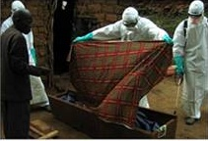

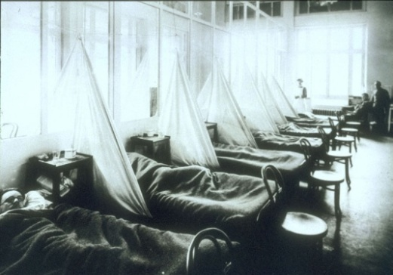
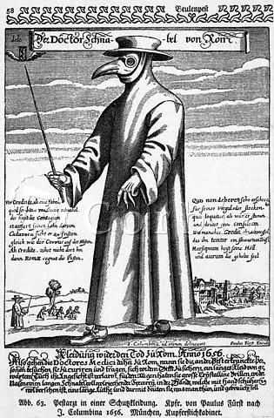
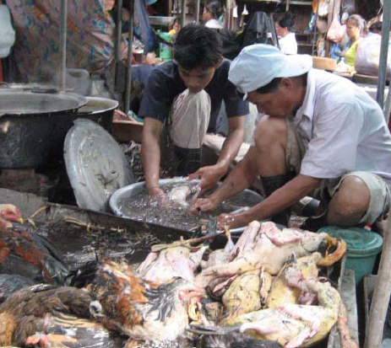
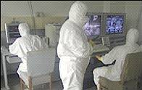
Perspectives on epidemics: individuals

Slide 17
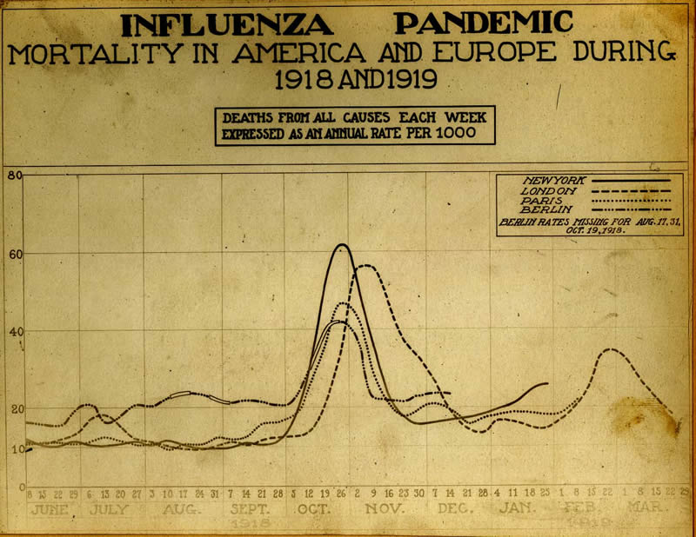
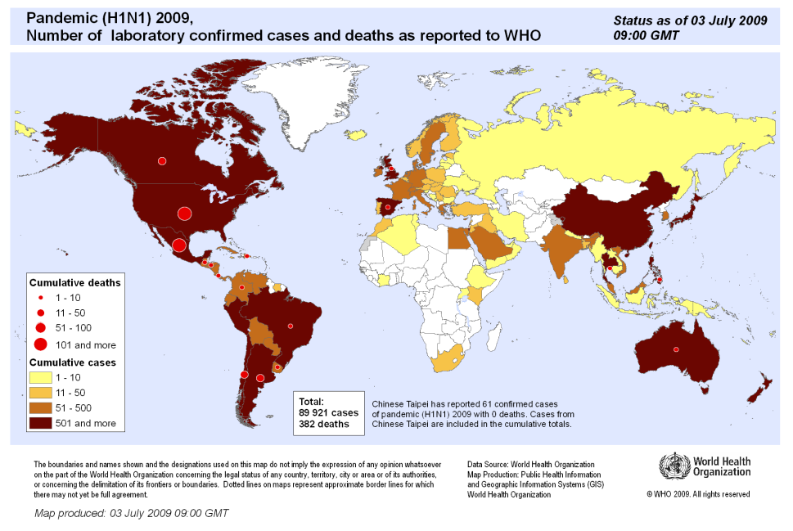
Another view: populations
H1N1, 1918-19
SARS, Hong Kong, 2003
Doubling time, attack rate
H1N1, 2009

Slide 18
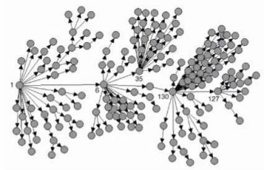
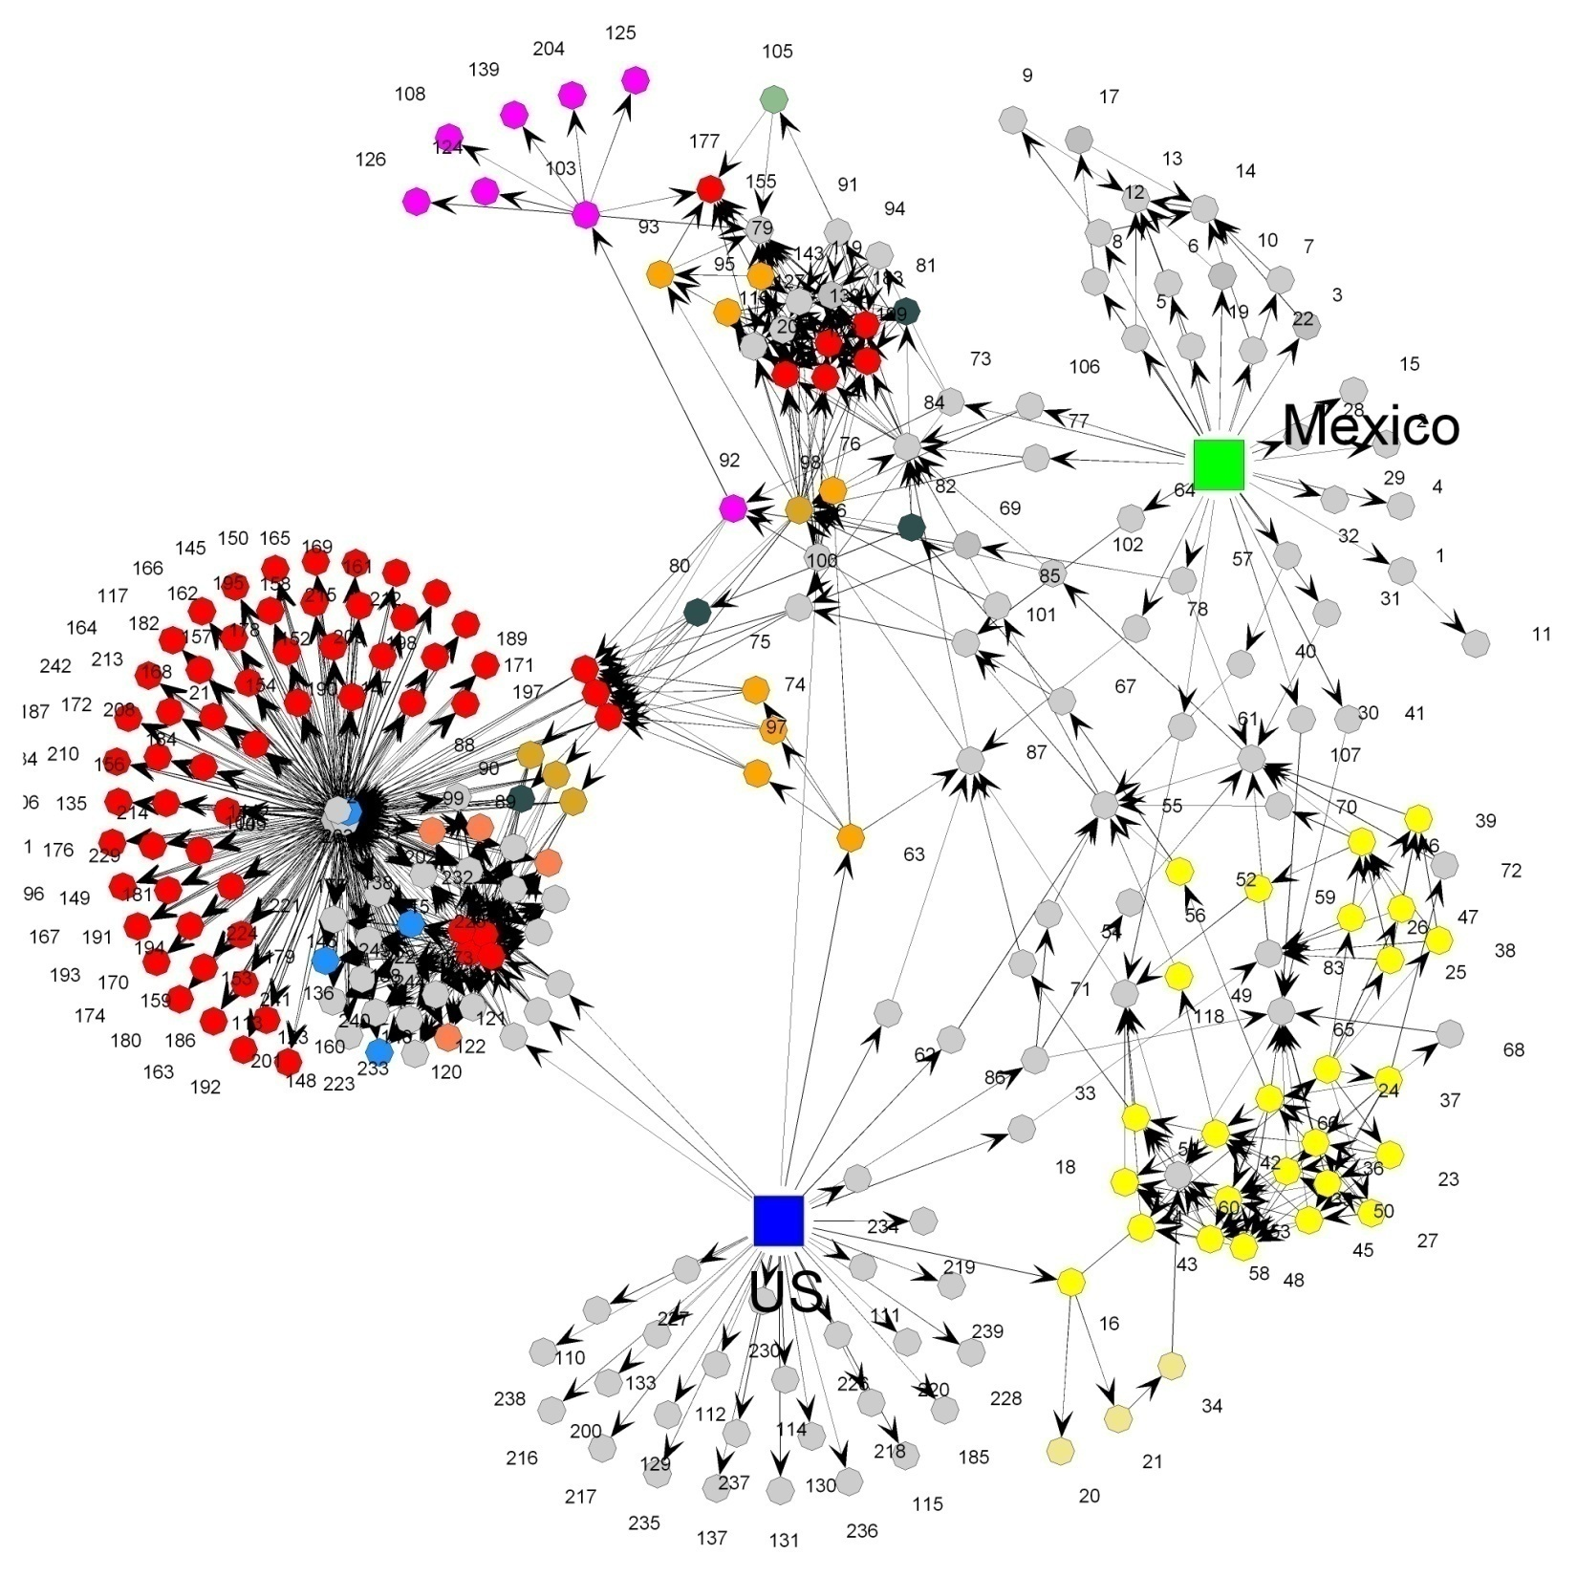
The bridge: contacts
Variola minor, England, 1966
SARS, Singapore, 2003
Secondary attack rate, offspring distribution, reproduction number, generation time
H1N1, UK, 2009

Slide 19

Modelling the contact process
8
7
Epidemic as chain reaction:
Governed by Reproduction Number R.
Need R₀ >1 for a large outbreak.
6
5
Y
4
3
2
1
0
1
2
3
4
t

Slide 20
Anatomy of a ‘SIR’ epidemic

Slide 21
Basic model
SIR model:
S (susceptible)
I (infected)
R (recovered/removed)
‘Mass action’ assumption – no space, contacts random:

Slide 22
Deconstructing R₀
R₀ determines effort required for control – 50% for R₀=2, 75% for R₀=4.
But R₀ not a fundamental constant.
Determined by:
Pathogen biology.
Host factors.
Host population structure.
Want mechanistic understanding of R₀ to predict impact of controls.
Need DATA.
e.g.
How much transmission occurs in the household, school or workplace?
How much can be prevented by case-finding/contact tracing?
How long are people infectious for?

Slide 23
What data are needed?

Slide 24
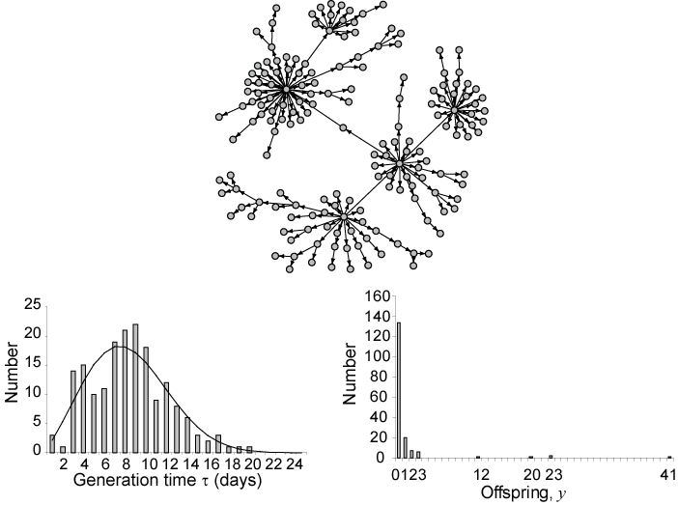
Data needs: detailed outbreak data
SARS – Singapore 2003
Generation time
Mean of offspring distribution = reproduction number=R

Slide 25
Data: natural history
Latent period, symptoms, serial interval distribution, shedding.
Models no longer just SIR – include real-world complexity.
Natural history key to control:
Long incubation period allowed smallpox to be eliminated.
Clear symptoms and no non-symptomatic transmission key to SARS control.
Influenza incubation period
Frequency
Influenza viral shedding
Days

Slide 26
Data: transmission
Household data for flu
Almost never observed.
Little quantitative data on mechanisms.
Some estimates of transmission rates for households etc.
But mostly estimate from surveillance data…

Slide 27
Data: epidemiological surveillance

Slide 28
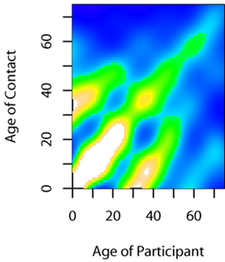
Data: populations
On demography, contacts, movements…

Slide 29
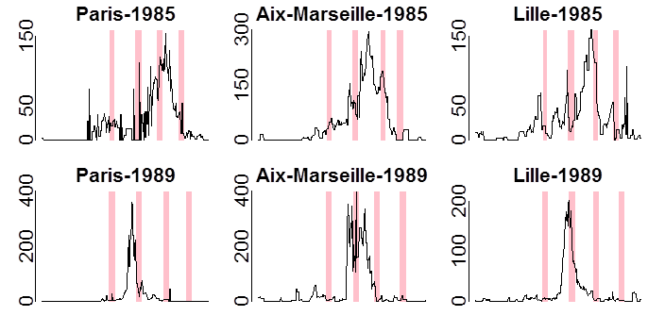
Data: interventions
Trial data useful for drugs/vaccines.
But very limited data for non-pharmaceutical measures.
Need to rely on (complex) analysis of observational data.
Bootsma & Ferguson, 2007, PNAS
Cauchemez et al, Nature 2008

Slide 30
How can models help?

Slide 31
Insights from simple models: herd-immunity
Vaccination, by reducing transmission, also protects those not vaccinated.
Need R<1, not R=0, so just need to vaccinate proportion p_{c} of population
the rest then get ‘free’ complete protection = ‘herd immunity’.

Slide 32
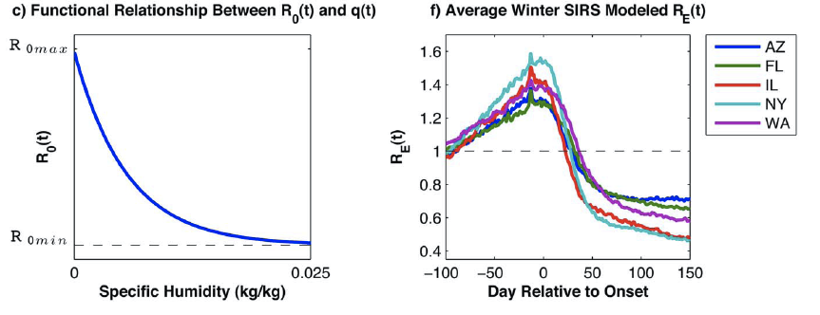
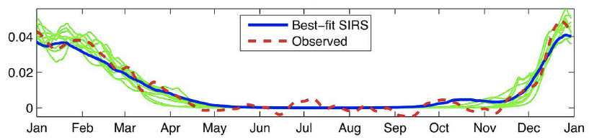
Much modelling still about insight
Models explain complex dynamics, can generate/test hypotheses.
Shaman et al, PLoS Biol, 2010

Slide 33
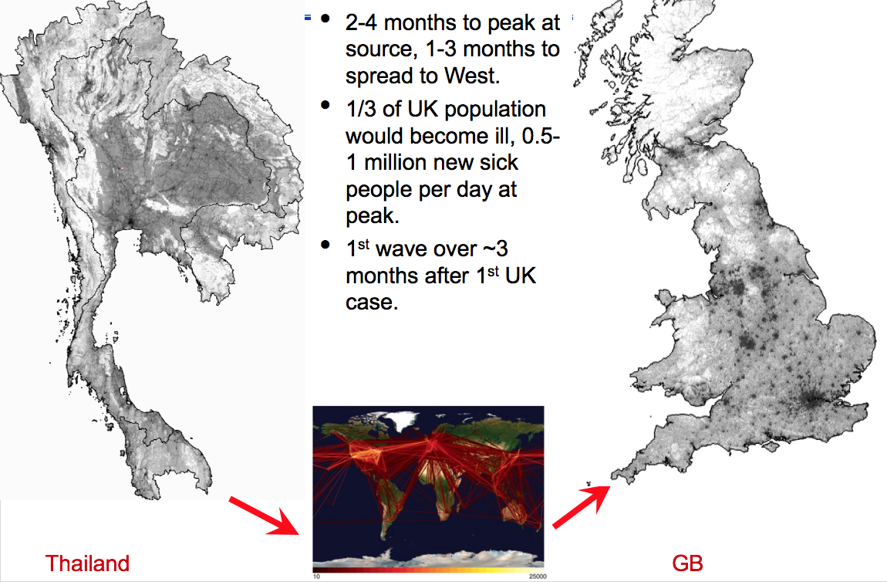
Pandemic preparedness

Slide 34
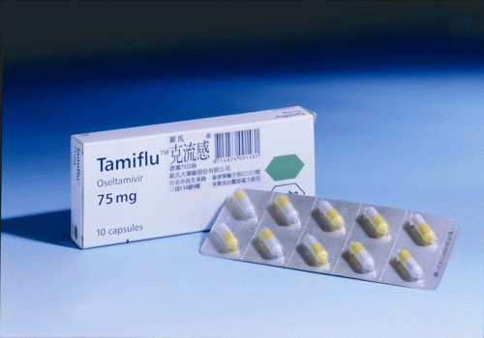

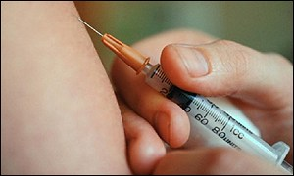
Modeling pandemic mitigation
Aim: reduce impact, buy time.

Slide 35
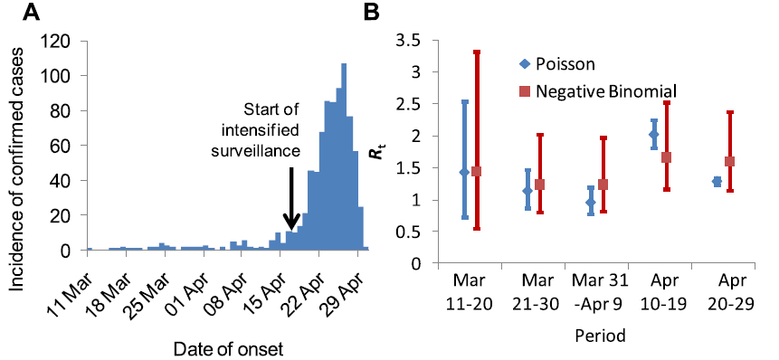
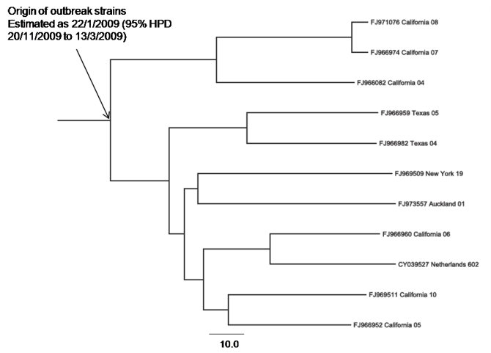
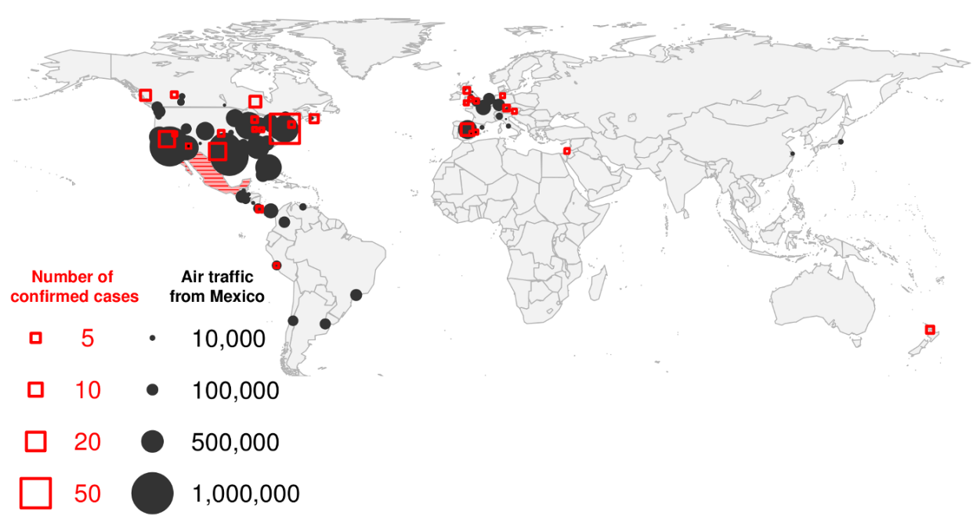
Real time modelling: 2009 H1N1 pandemic
How bad is it?
How far has it got?
How fast is it spreading
What can we do?
Did fairly well for H1N1 – estimated R₀, origin date, extent of spread and upper bound on severity within 3 weeks.
Fraser et al, Science 2009

Slide 36
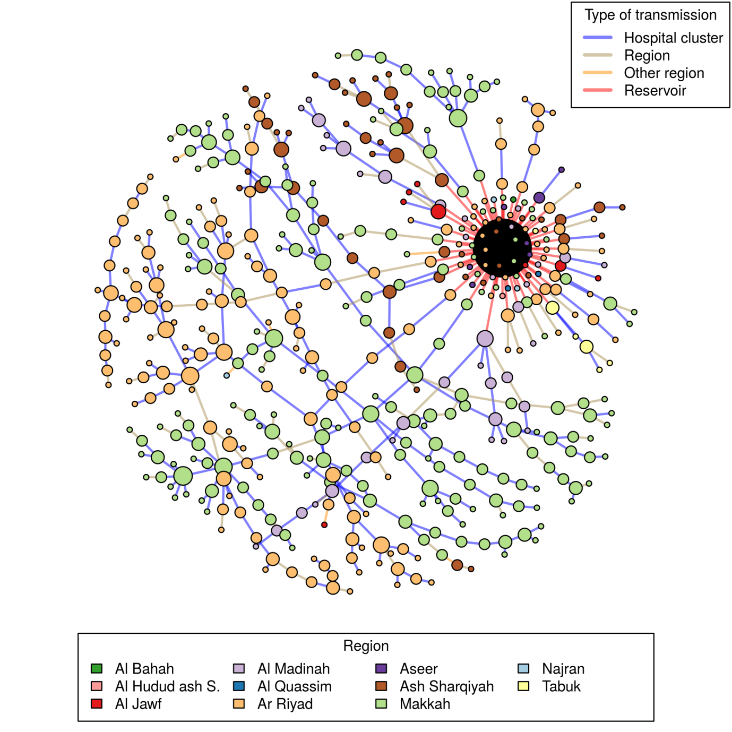
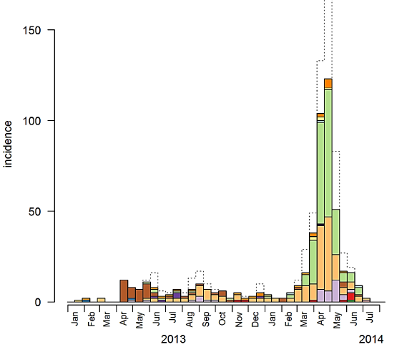
MERS: quantifying transmission
Need to quantify zoonotic vs human-to-human transmission
Infer transmission pathways from the KSA line-list for 2013-14
Transmission highly clustered by hospital, city, region
(Cauchemez et al, PNAS, 2016)

Slide 37
Ebola
MRC Centre acted in support of WHO HQ under IHR
Analysis of ‘line-list’ data – to understand epidemiology & transmission:
Incubation period, generation time
Severity/case under-ascertainment
Transmissibility
Impact of controls
Primary goal – improve situational awareness
>30 reports to WHO, CDC, UK govt & others since Aug 2014

Slide 38
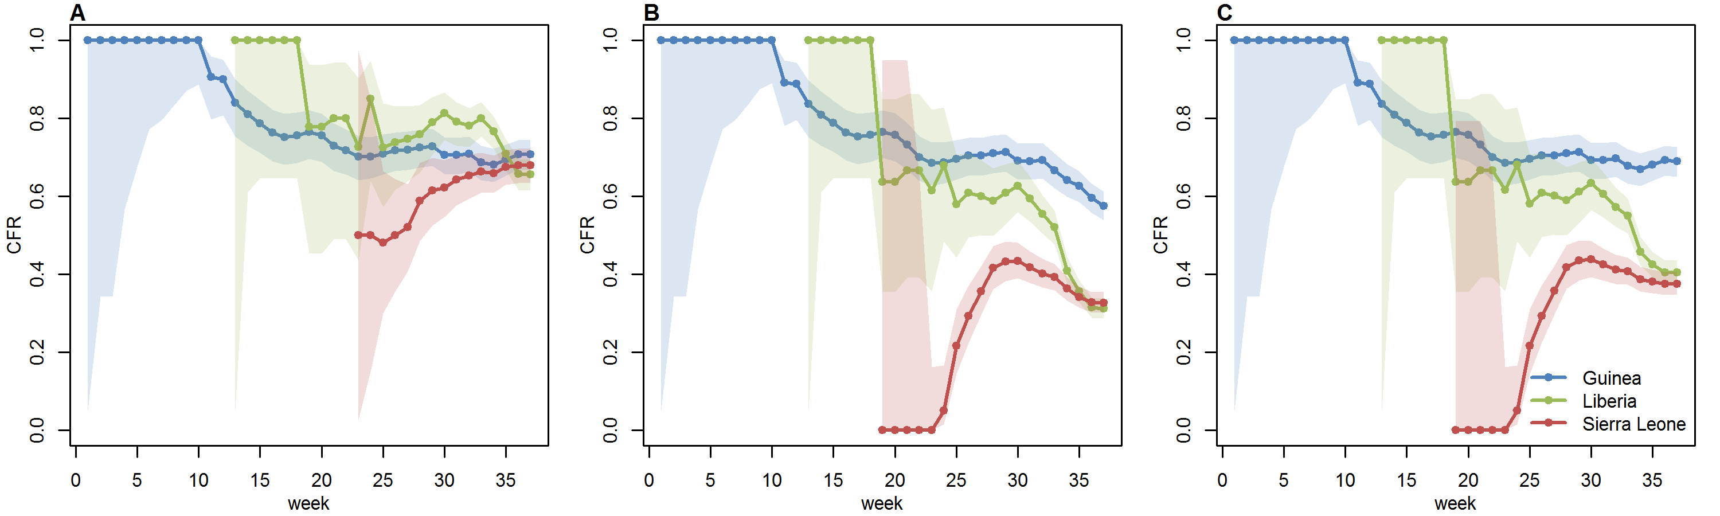
Severity
Naïve estimate (deaths/cases) was relatively low – 38%
Substantial apparent variation between countries
But <50% of cases had definitive clinical outcome recorded
Only analysing cases with clinical outcome gave CFR=71% (68-73) in Sept 2014, consistent between countries
Best estimate now - 65% (64-66)
Substantial variation by age, not by sex
naive
final outcome

Slide 39

What makes models reliable?
Quick answer: who does it!:
Programming not the hard bit.
Key: knowing the biology, collaborating with MDs/MPHs and public health bodies,
… plus expertise in modern methods.
‘Validation’ difficult – no 2 epidemics alike.
Statistical rigor needed.
Key judgement: how much detail to include?
Expectations need to be realistic - modelling not a substitute for data.

Slide 40
Conclusions

Slide 41

Conclusions
More mobile, more populous world – diseases spread faster than ever before
Resource limited, targeting important
Analysis and modelling can help in:
Contingency planning
Characterising new threats
Informing surveillance design
Assessing control policy options
The best modelling is rooted in data: biological, epidemiological, clinical
Key challenge: handling and communicating uncertainty

Slide 42
Introduction to the course
Aim: Biology → Model → Solutions
Also critical assessment of a model
Mix of lectures and practicals
Covering a range of important infectious diseases in humans
In this lecture we will touch on some basic concepts

Slide 43
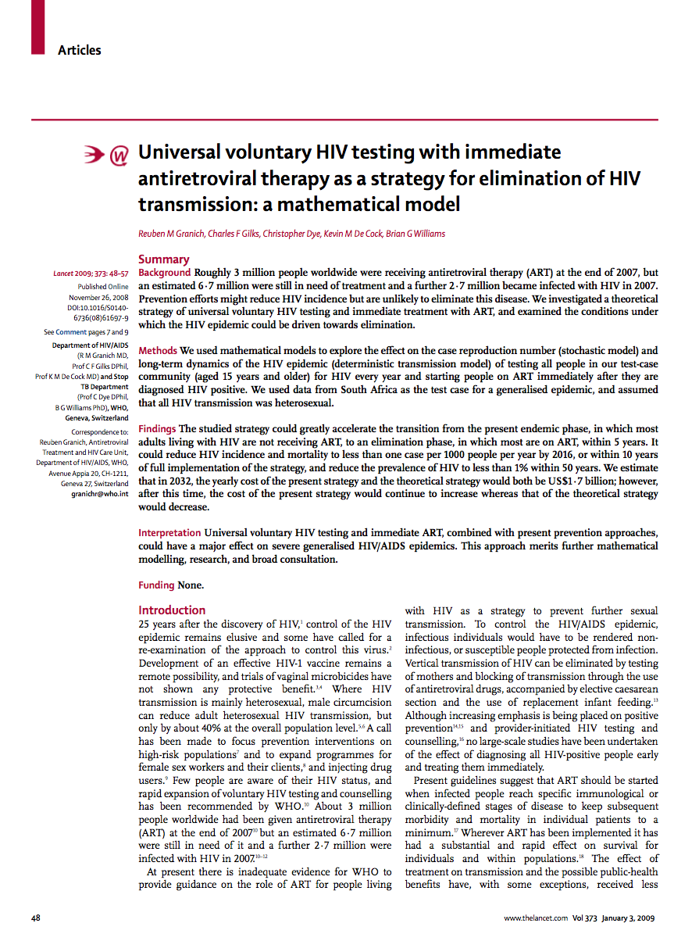
Don’t forget…
In week 9 (8th Dec) we will have a ‘critical analysis of an article’ exercise
Week 2 (20th Oct) is to start studying this article
If you got this article to review: would you accept, reject, or demand revisions?

